Slide 1

Stage Spaces

Slide 2
Contemporary stage spaces
Theatre spaces
  Proscenium, or picture stage
  Arena, or circle stage
  Thrust (usually three-quarter)
  Created, or “found” spaces
  Black box theatres

Slide 3
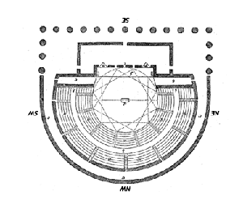
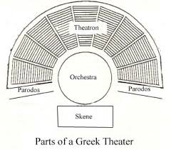
Early Greek stage spaces

Slide 4
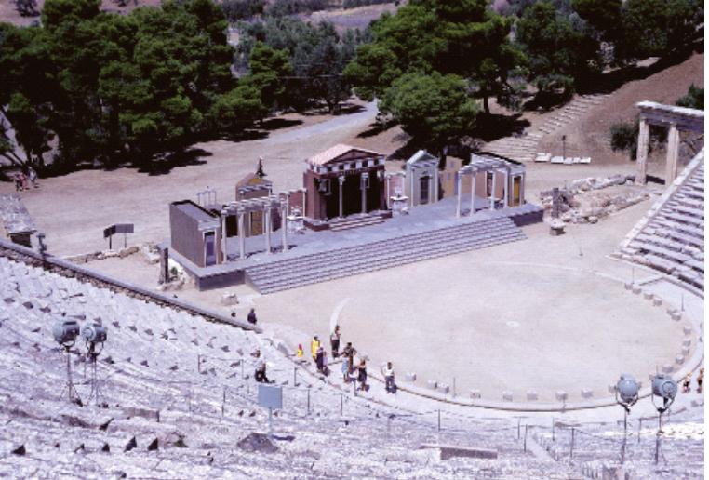
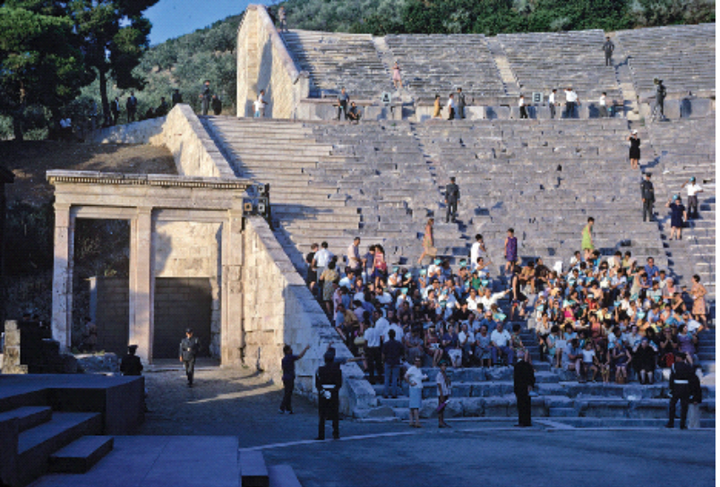
Later Hellenistic Greek Stage Spaces,
Epidaurus

Slide 5
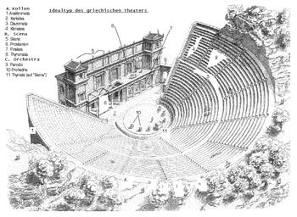
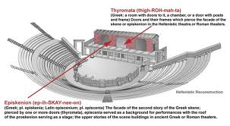
Hellenistic theatre stage designs

Slide 6
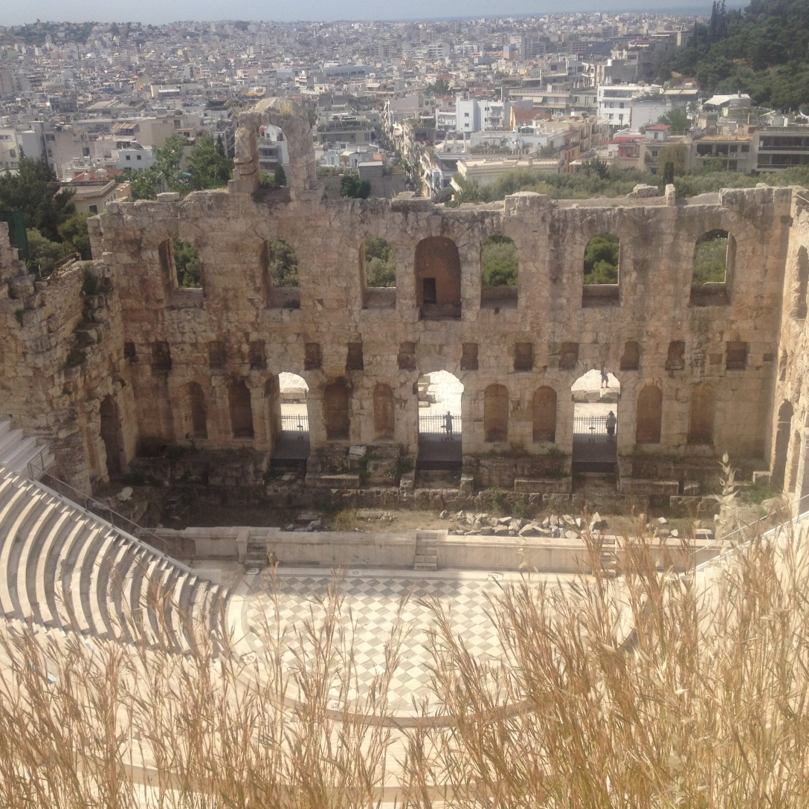
Existing Hellenistic stage space, found in North Africa

Slide 7
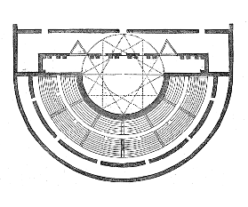
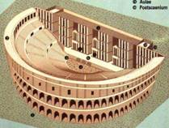
Roman stage spaces

Slide 8
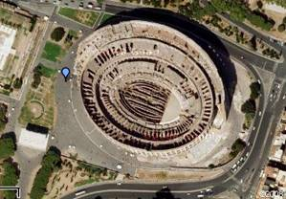
Roman Coliseum (model for modern sports arenas and amphitheatres)

Slide 9
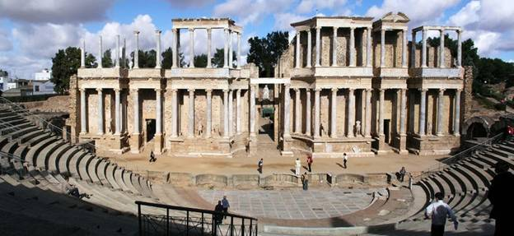
Remains of Roman theatre,
Merida, Spain

Slide 10
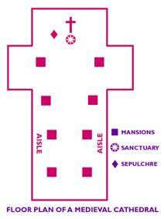

Medieval stage space, inside churches

Slide 11
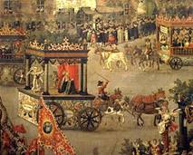
Medieval stage space, outside churches

Slide 12
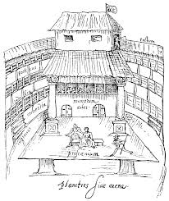
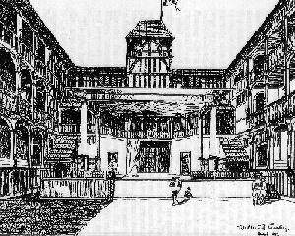
Elizabethan stage spaces
Swan Theatre Fortune Theatre

Slide 13
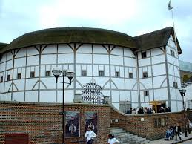
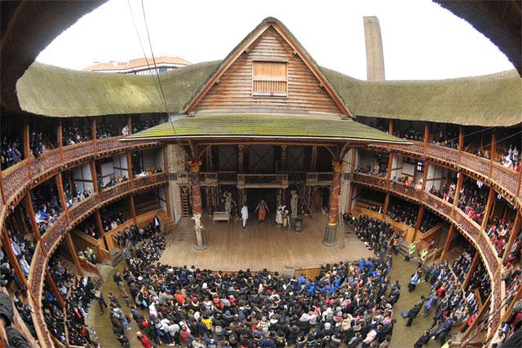
Shakespeare’s Globe Theatre, London

Slide 14
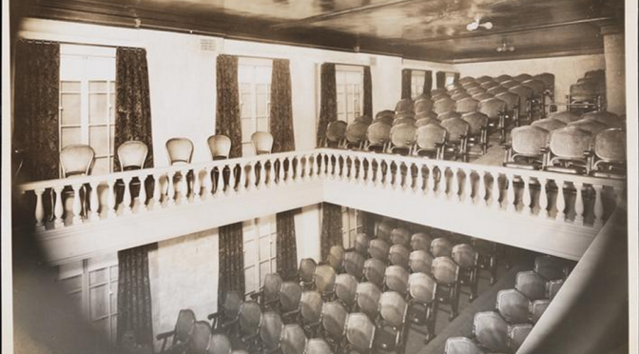
Spanish corrales models in the North American and the Caribbean
Repertorio Espanol, NYC
(aka Bramhall Theatre, 1930s)

Slide 15
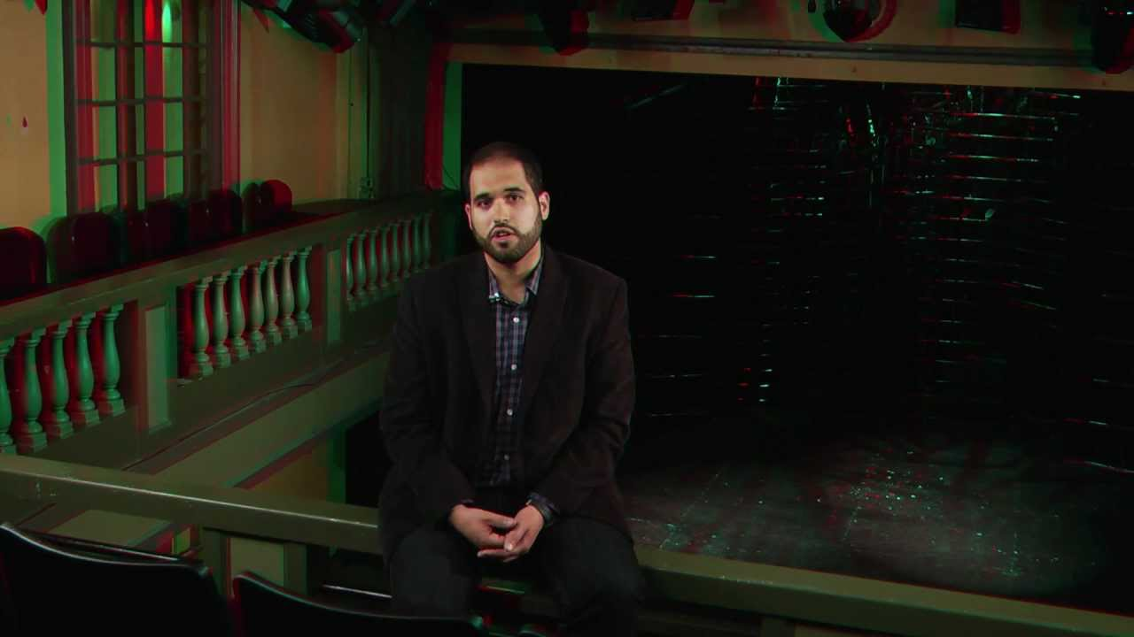
Repertorio Espanol today

Slide 16
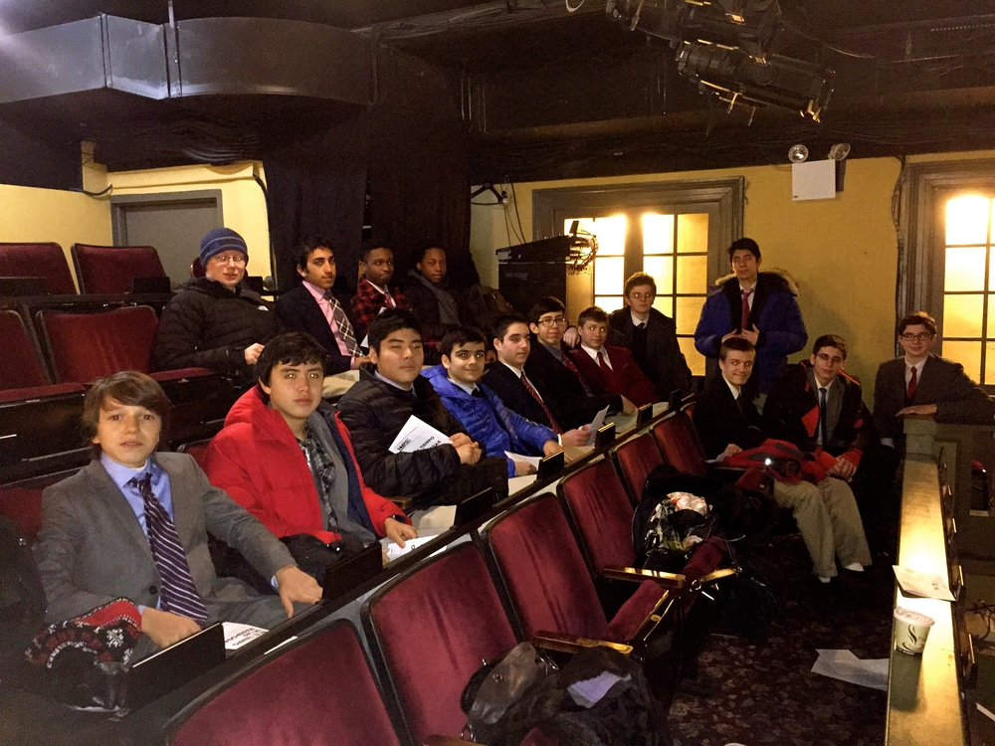
Repertorio Espaol, balcony

Slide 17
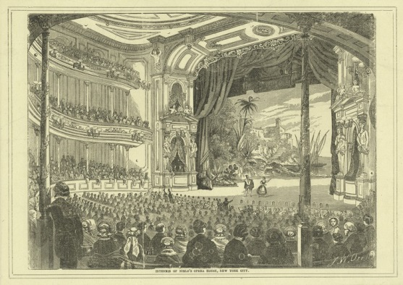
19th Century New York proscenium stage
Niblo’s Garden

Slide 18
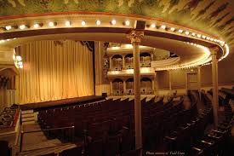
19th Century theatre – Renovated in 1960 in 19th Century style, State Theatre of Georgia
The Springer Opera House
Columbus, GA

Slide 19
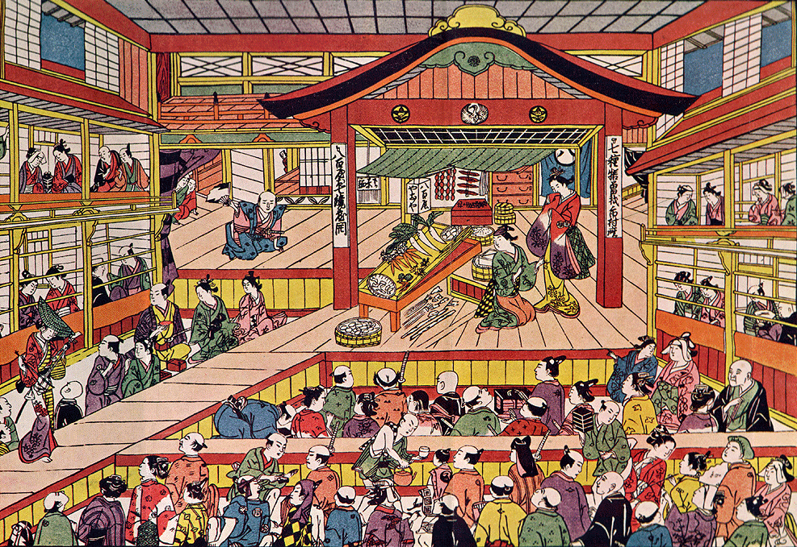
Other international theatre spaces –
Kabuki, Japan (drawing from 17th century)

Slide 20
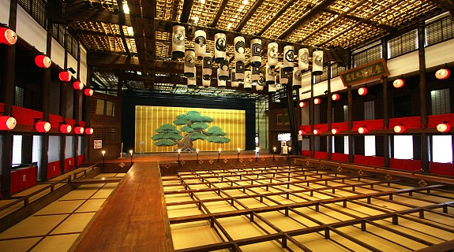
Modern Kabuki theatre, Japan

